Slide 1
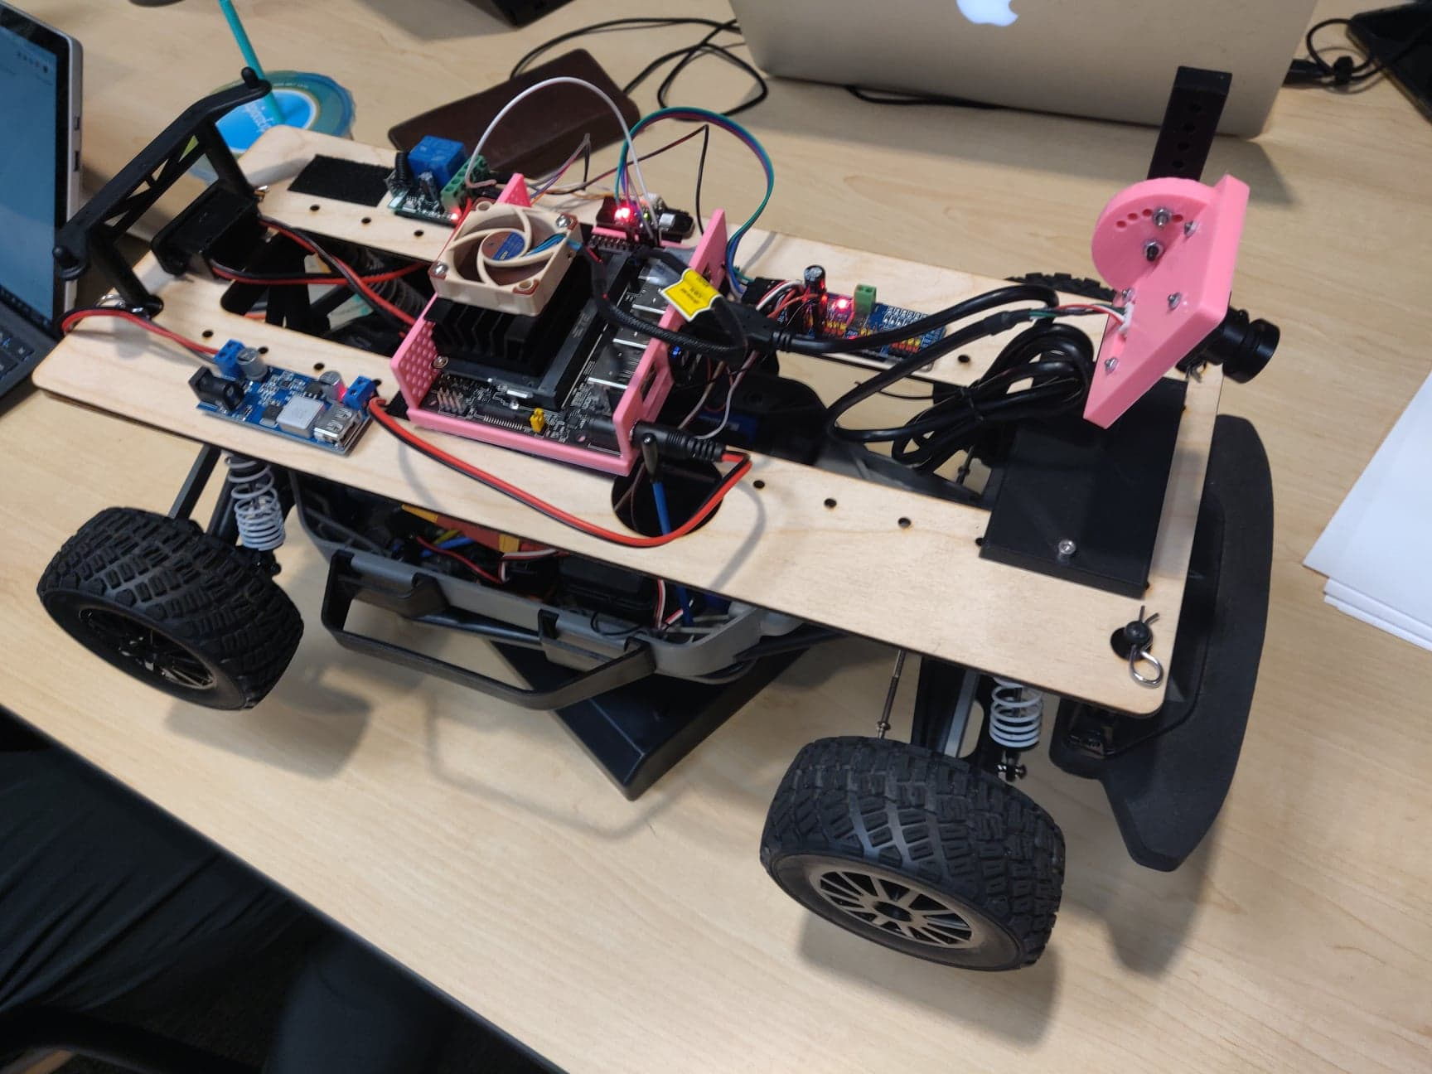

Team 4 - Autonomous Bus
Richard Lai - MAE
Nikhil Challa - Extension
JiaYe Wang - ECE
Edison Chiu - ECE
Summer 2019 MAE 148 Team 4
Pg 1 of 9

Slide 2
Goals
a. Autonomous Driving Around Track. (using opencv)
b. Multiple Bus Stands along track [2 in Demo, will need OpenCV to extract ‘P x’ sign; details below*], with Sign placements as ‘P 1’, ‘P 2’ Etc. and stopping at these stops when requested
c. Running Socket process to accept any command from external device to request for pick up; drop off. [We will use laptop and have multi-thread server to accept connections from multiple clients**]
d. Bonus if time permits: Running Command Center process to change between different modes. [Demo2 modes, ‘School Bus’ mode and ‘Normal Passenger’ mode; details below***]
Summer 2019 MAE 148 Team 4
Pg 2 of 9

Slide 3
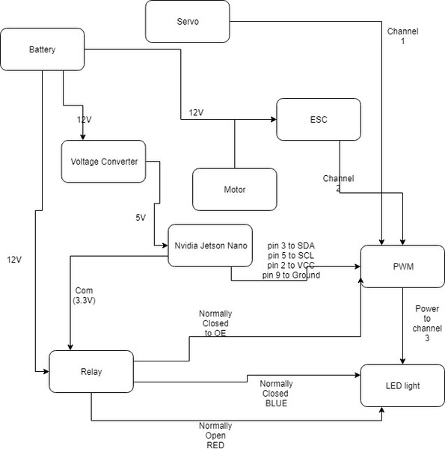
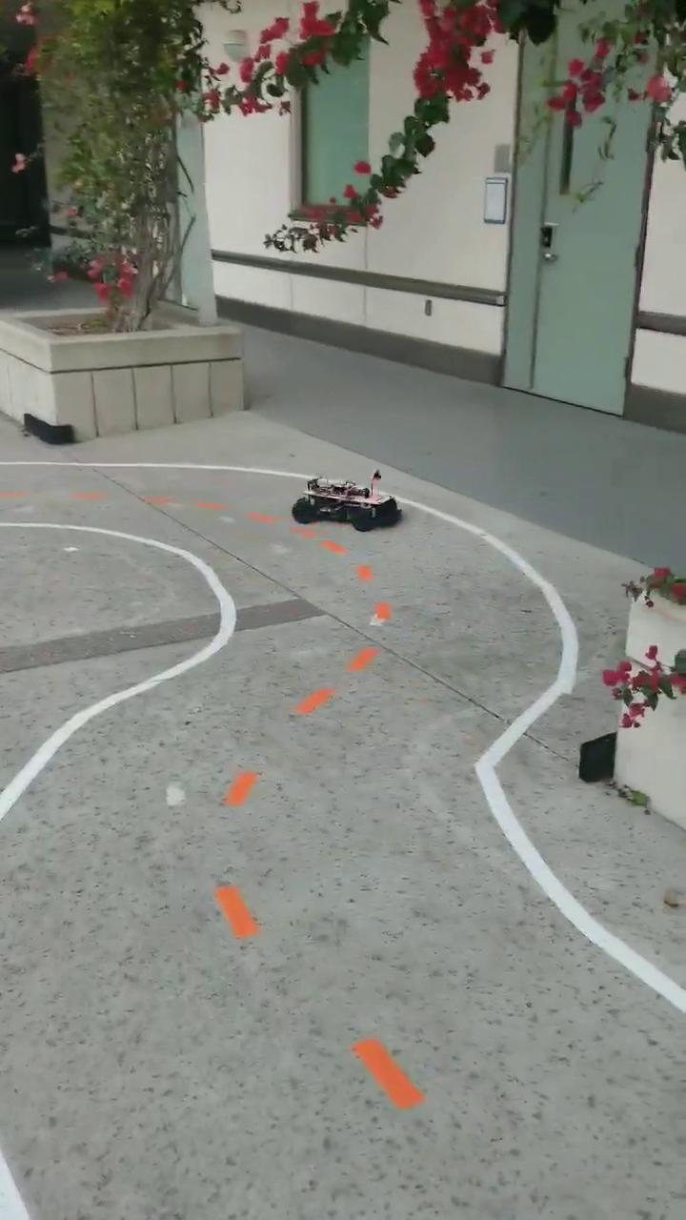

Robot Schematic and outdoor/indoor autonomous driving
Schematic
Outdoor
Indoor
Summer 2019 MAE 148 Team 4
Pg 3 of 9

Slide 4
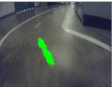

Autonomous Driving using opencv
Detect middle part of the lane
Use region of interest
Make contours out of the middle part of the lane
Find midpoint of the contours and adjust steering based on the x and y coordinate of the midpoint
Summer 2019 MAE 148 Team 4
Pg 4 of 9

Slide 5
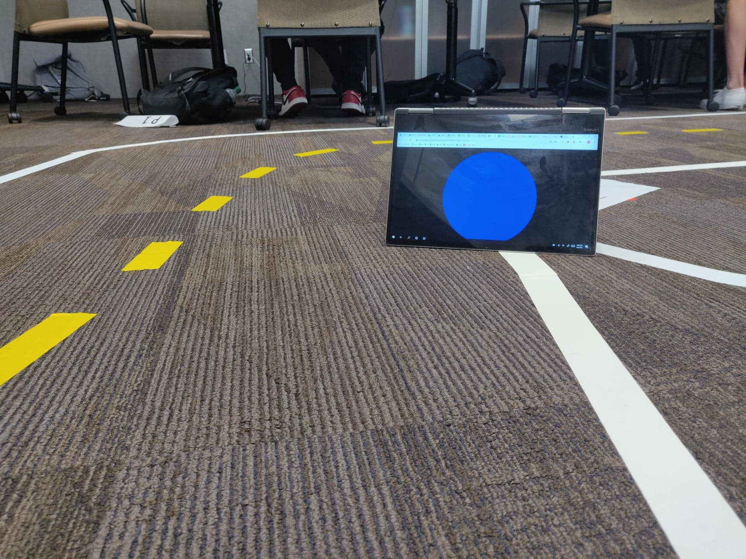
What we achieved
a. Autonomous Driving Around Track.
b. 2 circular colored bus stop signs detected with opencv
c. Running Socket process to accept any command from external device to request for pick up; drop off.
d. Running Command Center process to change between different modes.
Summer 2019 MAE 148 Team 4
Pg 5 of 9

Slide 6
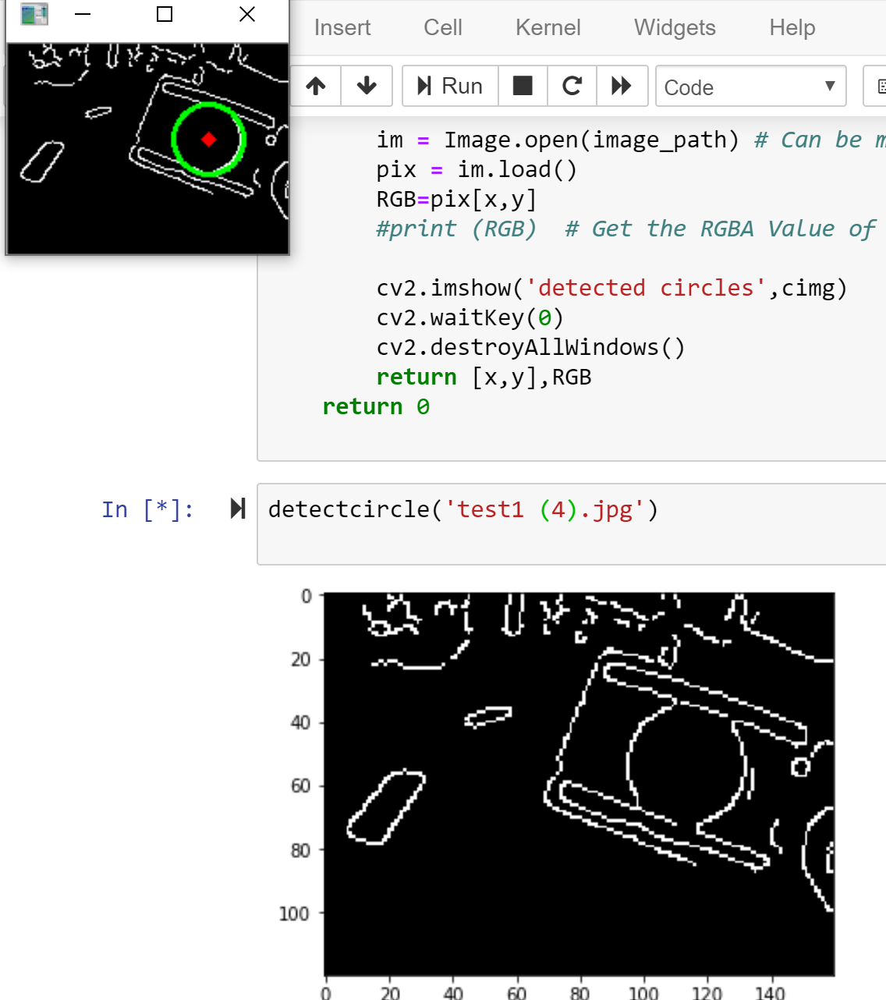
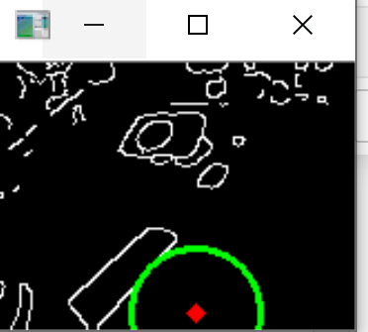
Challenges
Tried to detect letters using opencv (noticed that the code was “lagging” after integration with autonomous driving)
Tried using hough circle to detect different bus stop then do the classification
However, it will detect too many false circles and we need to adjust parameters constantly to ensure the output quality.
Finally, we choose to detect different color instead of detect circles for the bus stop
Summer 2019 MAE 148 Team 4
Pg 6 of 9

Slide 7
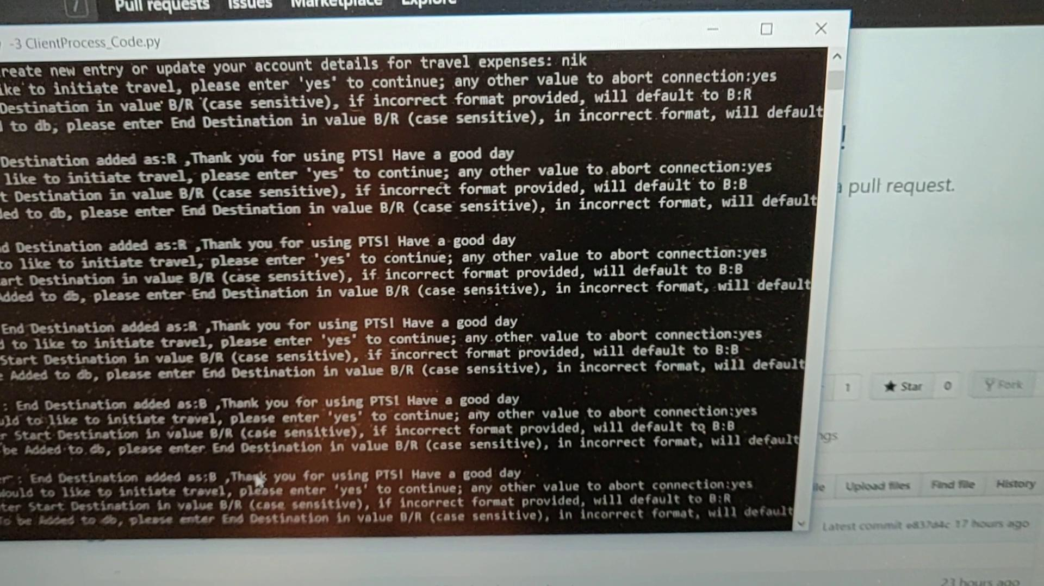
Demo 1
Client types which stops he/she wants to get off/on at. (Gets on at Blue and Gets off at Red
The bus is autonomously follows the track until it reads an input from the database
When the bus sees the bus stop, it checks the database for a user input. It then stops at designated stops (stops at Blue to pick-up and stops at Red to drop-off) based on user input.
Summer 2019 MAE 148 Team 4
Pg 7 of 9

Slide 8
Demo 2
Client types which stops he/she wants to get off/on at. (Gets on at Blue and Gets off at Red
The bus is autonomously follows the track until it reads an input from the database
When the bus sees the bus stop, it checks the database for a user input. It then stops at designated stops (stops at Blue to pick-up and stops at Red to drop-off) based on user input.

Slide 9
Detecting words and integration
The bus stops when it sees the words “two” and “three
Lack of computing power when integrated with code
Summer 2019 MAE 148 Team 4
Pg 9 of 9

Slide 10
Possible future development
implement more reliable track following algorithm
Taking advantage of cuda cores
Stopping to the side of the road
Obstacle avoidance
detecting bus stops with characters using opencv (a more efficient way)
increase the overall speed of the car/bus
GUI for client
More information on Code/Limitations/Schematic/etc refer to below link
https://drive.google.com/file/d/1lIGK5Iru4-lHcwW_muJnCYGOyUxvKY6Y
Summer 2019 MAE 148 Team 4
Pg 8 of 9

